Slide 1
Books Sales Data Analysis Dashboard
Eshika Pardeshi
2025 Sept 25

Slide 2

Overview
This dashboard provides a comprehensive analysis of book sales data, focusing on key metrics and trends. It is designed to offer a quick and clear understanding of the market, which can be useful for authors, publishers, and marketers. The dashboard is interactive, allowing for filtering by author and publisher to drill down into specific data points.
1

Slide 3
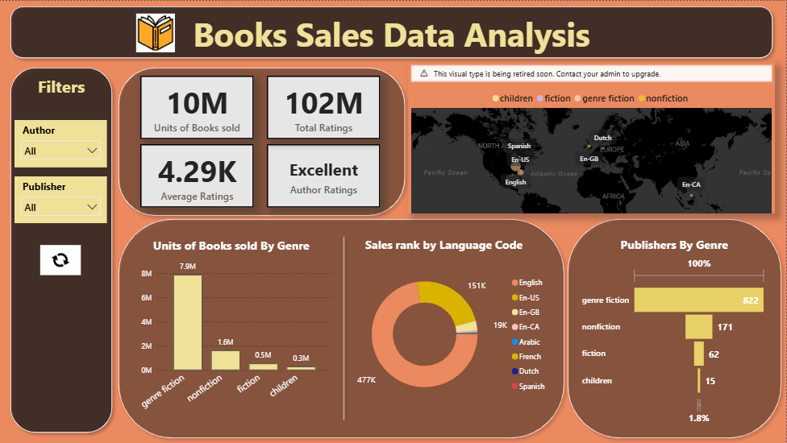
2

Slide 4

Key Performance Indicators
10M Units of Books Sold: This metric highlights the total volume of books sold, providing a top-level view of overall sales performance.
102M Total Ratings: This shows the immense engagement from readers, indicating the popularity and reach of the books in the dataset.
4.29K Average Ratings: This metric gives an insight into the general sentiment of readers, with a high average rating suggesting a positive reception across the board.
Excellent Author Ratings: This is a qualitative measure, likely derived from the average ratings, that provides a quick and easily understandable summary of the authors' performance.
3

Slide 5
Analysis by Genre
Units of Books Sold by Genre: This bar chart is used to visually compare the sales performance of different book genres. The chart makes it immediately clear that "genre fiction" is the top-performing genre by a significant margin. The bars for the other genres are much shorter, indicating lower sales volumes. This is a very effective way to show a head-to-head comparison.
4

Slide 6
Sales by Language and Publisher
Sales Rank by Language Code: This donut chart is used to display the proportional breakdown of sales by the language of the book. It helps to quickly identify the dominant languages in the market. The larger segments clearly indicate that English and English (US) are the most popular, followed by smaller contributions from other languages like Arabic and French. Donut charts are excellent for showing parts of a whole, and in this case, they effectively show the distribution of sales by language.
Publishers By Genre: This bar chart displays the count of publishers for each genre. The numbers inside the bars provide the exact count, showing that "genre fiction" has the highest number of publishers, followed by "nonfiction." This suggests that "genre fiction" is a highly competitive and popular category not only among readers but also among publishers.
5

Slide 7
Summary and Key Takeaways
The dashboard reveals a strong market for "genre fiction," which leads in both sales volume and the number of publishers. English is the dominant language for book sales. The overall market shows strong reader engagement with a high number of total ratings and a positive average rating. This data suggests that focusing on "genre fiction" and catering to the English-speaking market could be a successful strategy.
6

Slide 8
Thank you
for listening!
Eshika Pardeshi
2025 Sept 25

